Slide 1



Conserving evolutionary processes
Jeffrey Hanson
jeffrey.hanson@uqconnect.edu.au
jeffrey-hanson.com

Slide 2



Acknowledgements
Richard Fuller
Jonathan Rhodes
Cynthia Riginos
Hugh Possingham
Stuart Butchart
Graeme Buchanan
Carlo Rondinini
Francesco Ficetola
IntraBioDiv project
NeCTAR

Slide 3
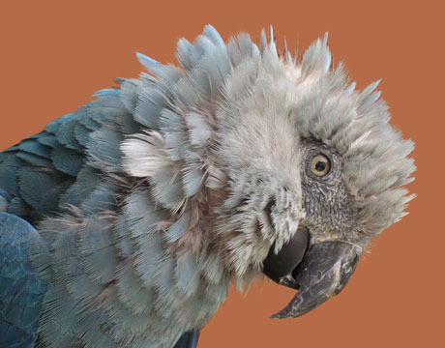
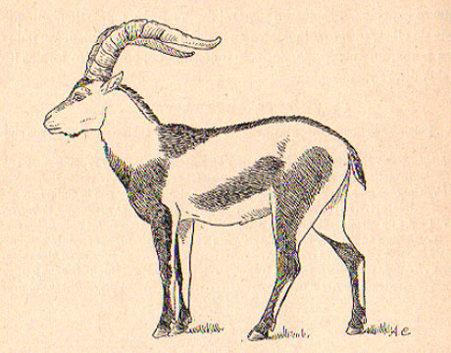
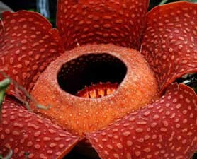
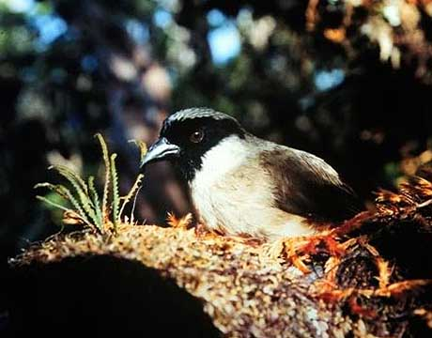
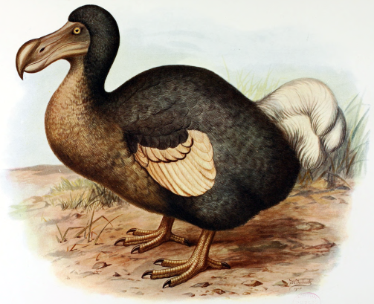
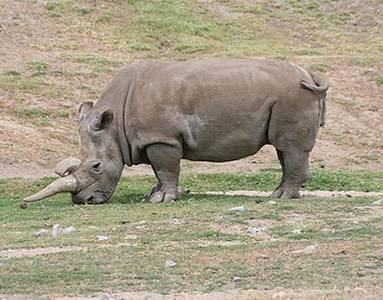
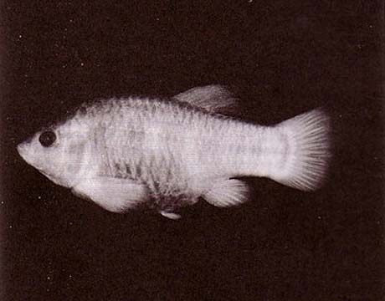
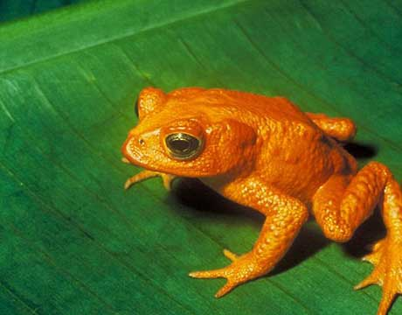
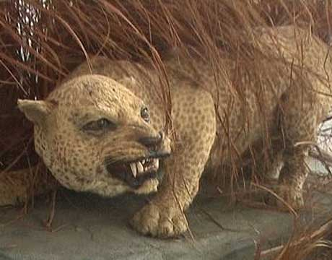
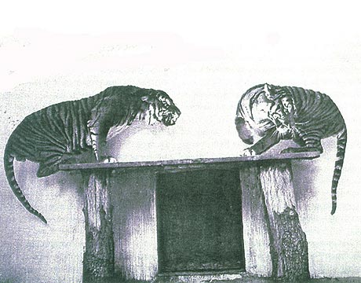
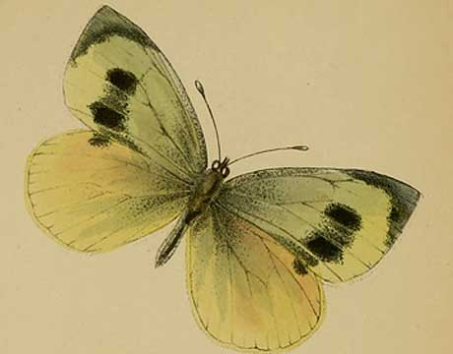
Global biodiversity crisis
Notes:
- high extinction rate
- conservation aims to maintain existing patterns of biodiversity and the processes that sustain them
- areas set aside to preserve biodiversity, and spearhead direct management actions

Slide 4
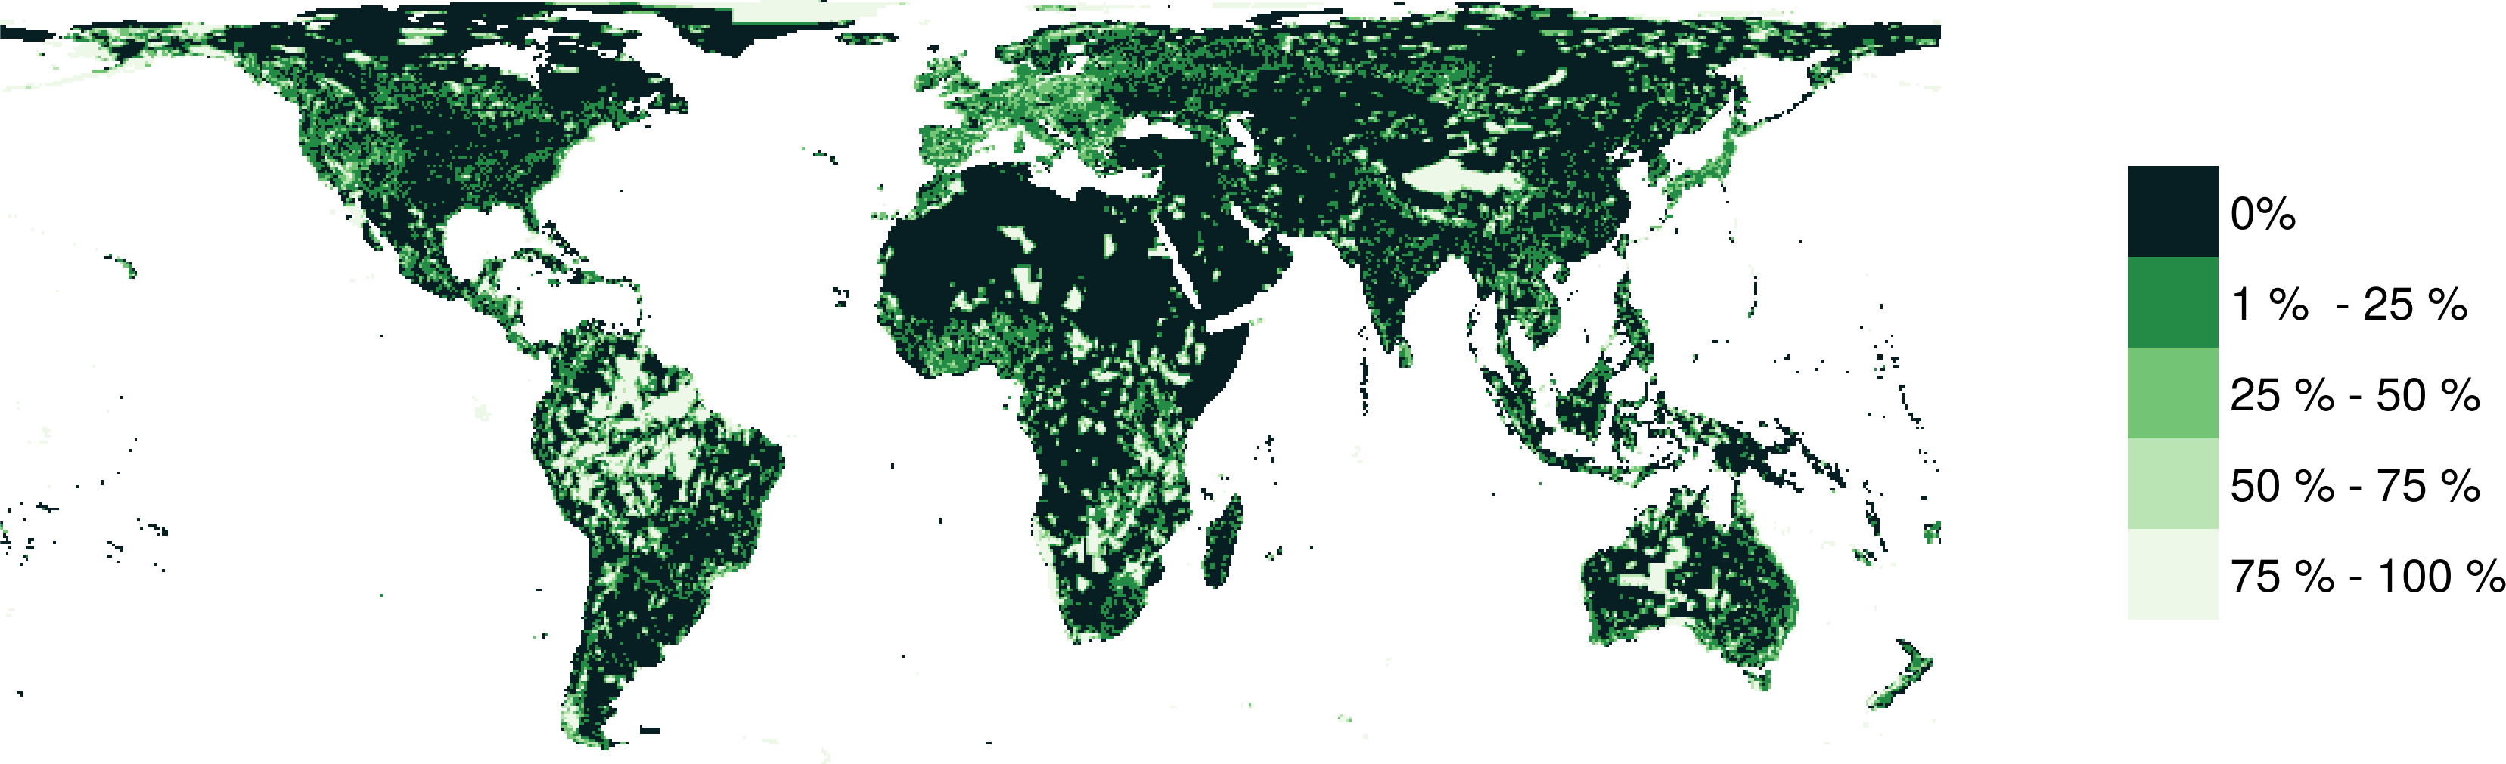
Protected areas

Slide 5
Reserve selection
Notes:
- not all remaining habitat can be preserved
- achieve conservation objectives for minimal cost
- modern systematic conservation planning primarily focusses on representing species
- however, this ignores intra-specific biodiversity

Slide 6
Reserve selection

Slide 7
Reserve selection

Slide 8



CARE Principles
Comprehensive
Adequate
Representative*
Efficient
*Assuming that no significant intra-specific variation

Slide 9
raptr: Representative and adequate prioritization toolkit in R
Hanson et al. 2018 Methods Ecol. & Evol.

Slide 10
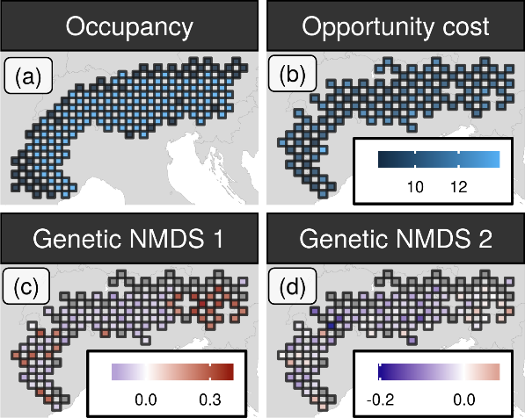
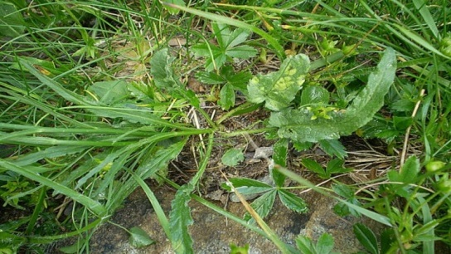
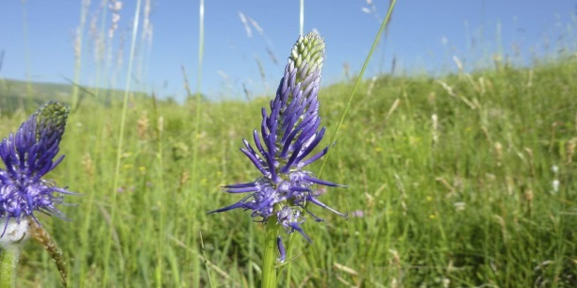
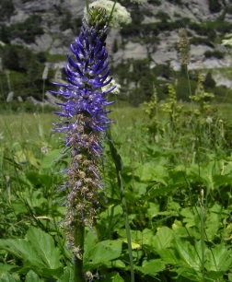
Case study
betony leaved rampion

Slide 11
Case study
betony leaved rampion

Slide 12
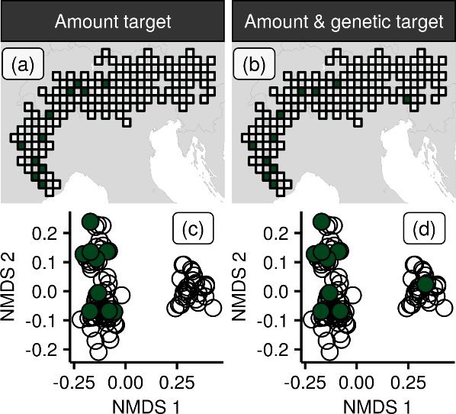
Case-study
10 % habitat
target
10 % habitat
target
+
95 % genetic
variation target

Slide 13
Case-study
10% habitat
target
10% habitat
target
+
95% genetic
variation target

Slide 14
Can we use environmental and geographic variables as surrogates for genetic variation in conservation planning?
Hanson et al. 2017 PNAS

Slide 15
Evolutionary processes
Species range
Population

Slide 16
Evolutionary processes
Species range
Population

Slide 17
Evolutionary processes
Species range
Population

Slide 18
Evolutionary processes
Species range
Population

Slide 19
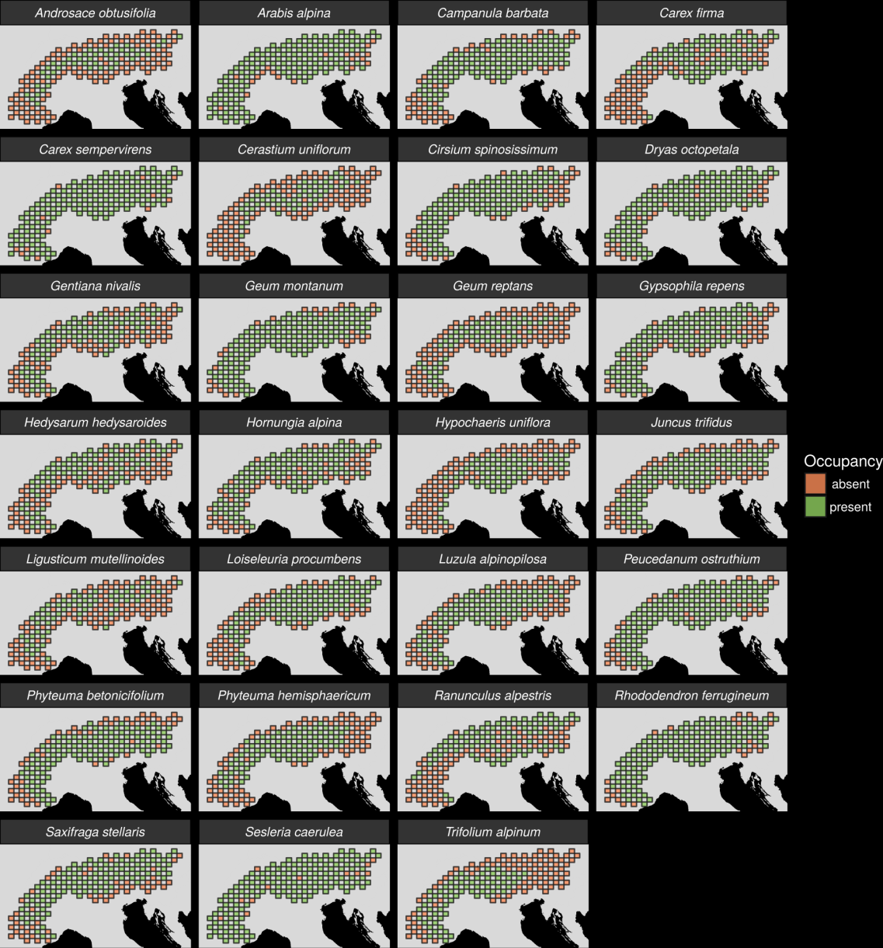
27 plant species
Different dispersal
Different life-histories
Different niches

Slide 20
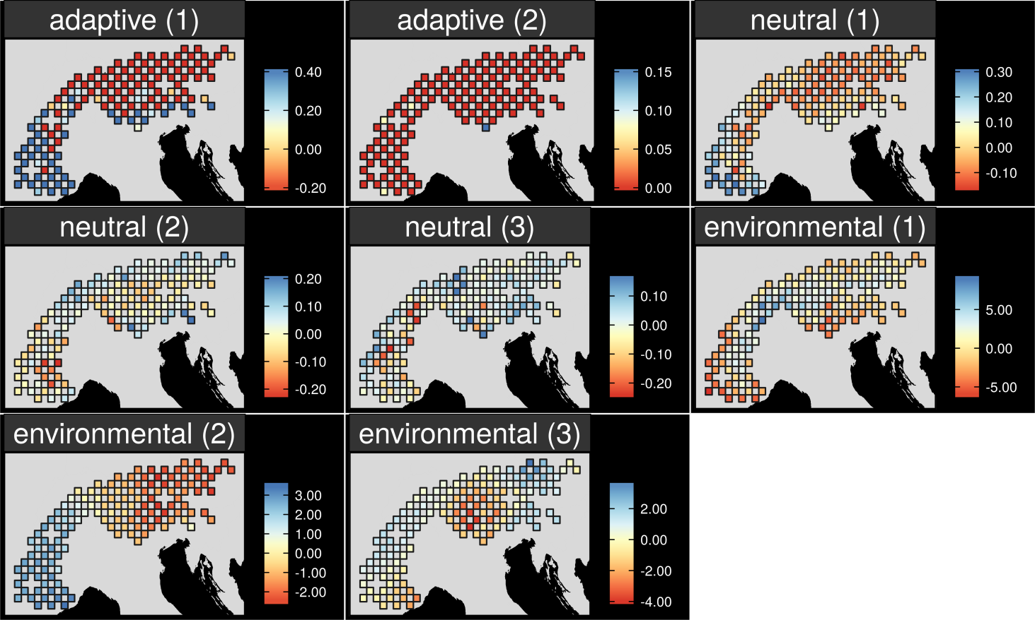
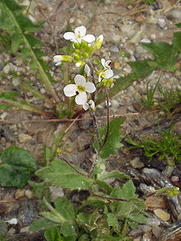
Map intra-specific variation
Arabis alpina

Slide 21
Map intra-specific variation
Arabis alpina

Slide 22
Map intra-specific variation
Arabis alpina

Slide 23
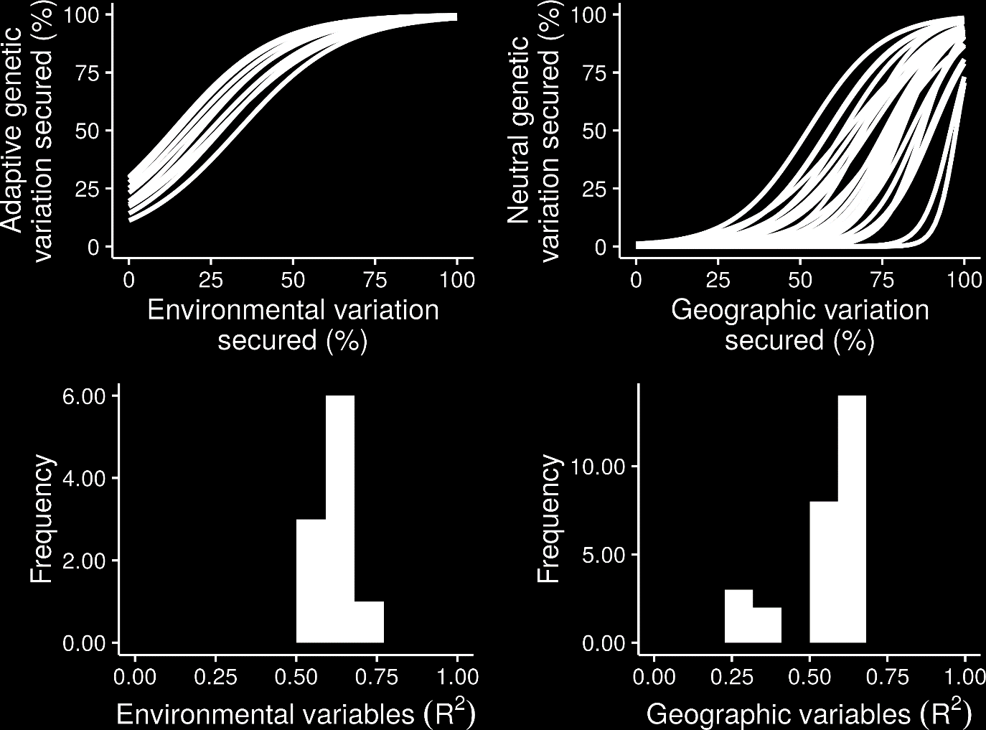
What is the relationship?

Slide 24
What is the relationship?

Slide 25
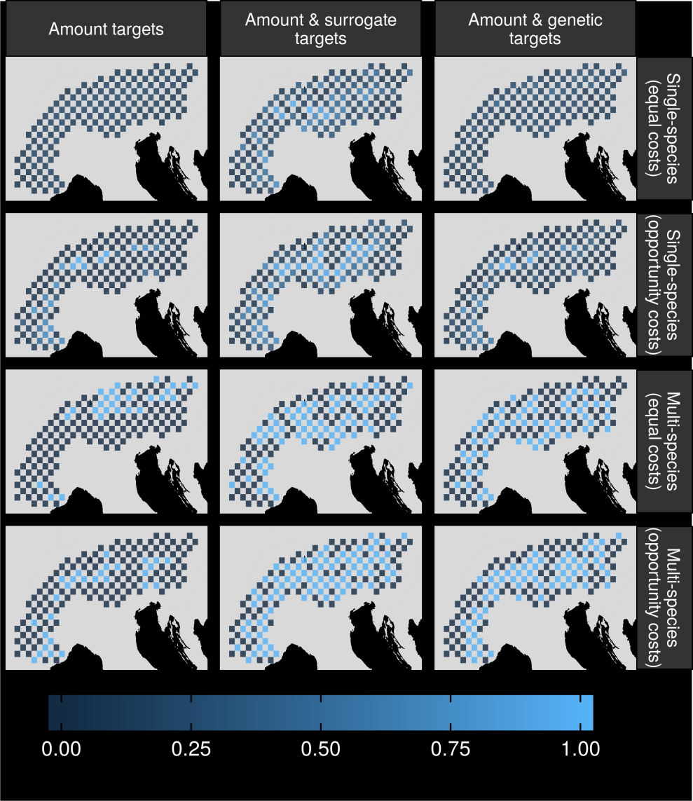
Can surrogates inform our decisions?

Slide 26
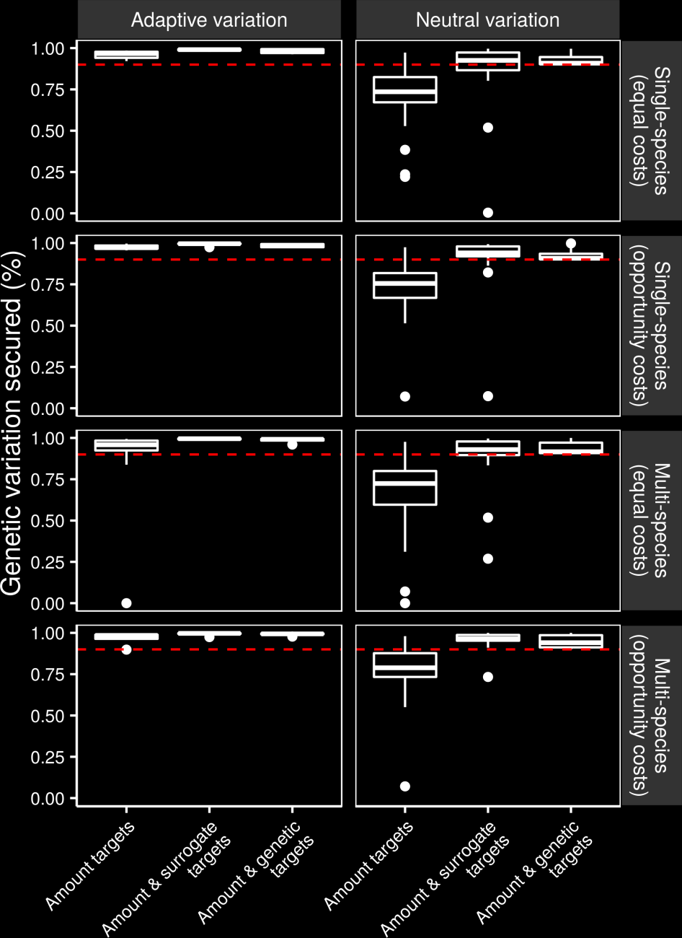
Can we make better decisions using surrogates?

Slide 27
Can we make better decisions using surrogates?

Slide 28
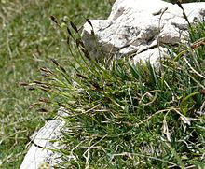
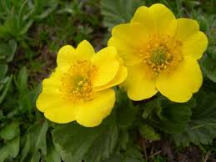
Surrogate performance
Effective for most studied species
Conventional methods may capture adaptive variation
Performance of geographic distances may depend on dispersal mechanisms

Slide 29
How good are conventional approaches for capturing gene flow and can we do better?
Hanson et al. 2019 J. Appl. Ecol.

Slide 30
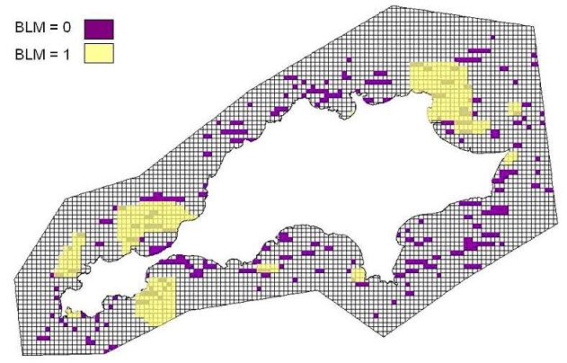
Conventional approaches for connectivity
More clumped -> more connectivity
No species-specific data
No landscape data

Slide 31
Reserve selection using genetic data
Suitable habitat
Dispersible habitat
Solution
Suitable
High connectivity
Selected
Unsuitable
Low connectivity

Slide 32
Reserve selection using surrogate data
Suitable habitat
Suitable habitat
Solution
Suitable
Selected
Unsuitable

Slide 33
Performance evaluation
Genetic-based solution
Surrogate-based solution

Slide 34
Performance evaluation
Genetic-based solution
Dispersible habitat
Surrogate-based solution
Maximum 5 units of
connected habitat
Maximum 2 units of
connected habitat

Slide 35
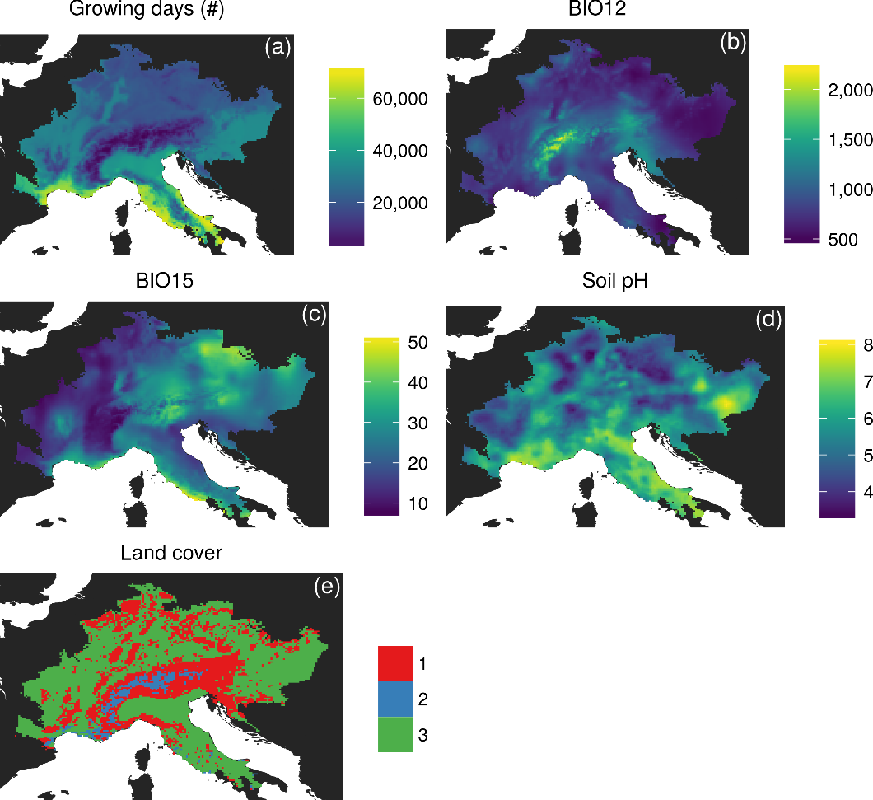
Environmental data

Slide 36
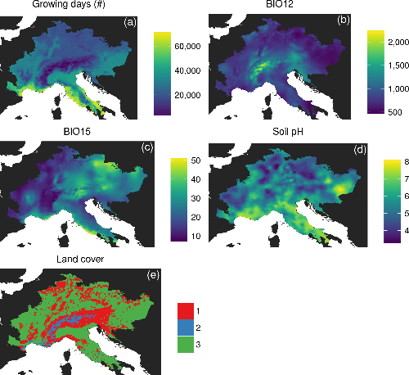
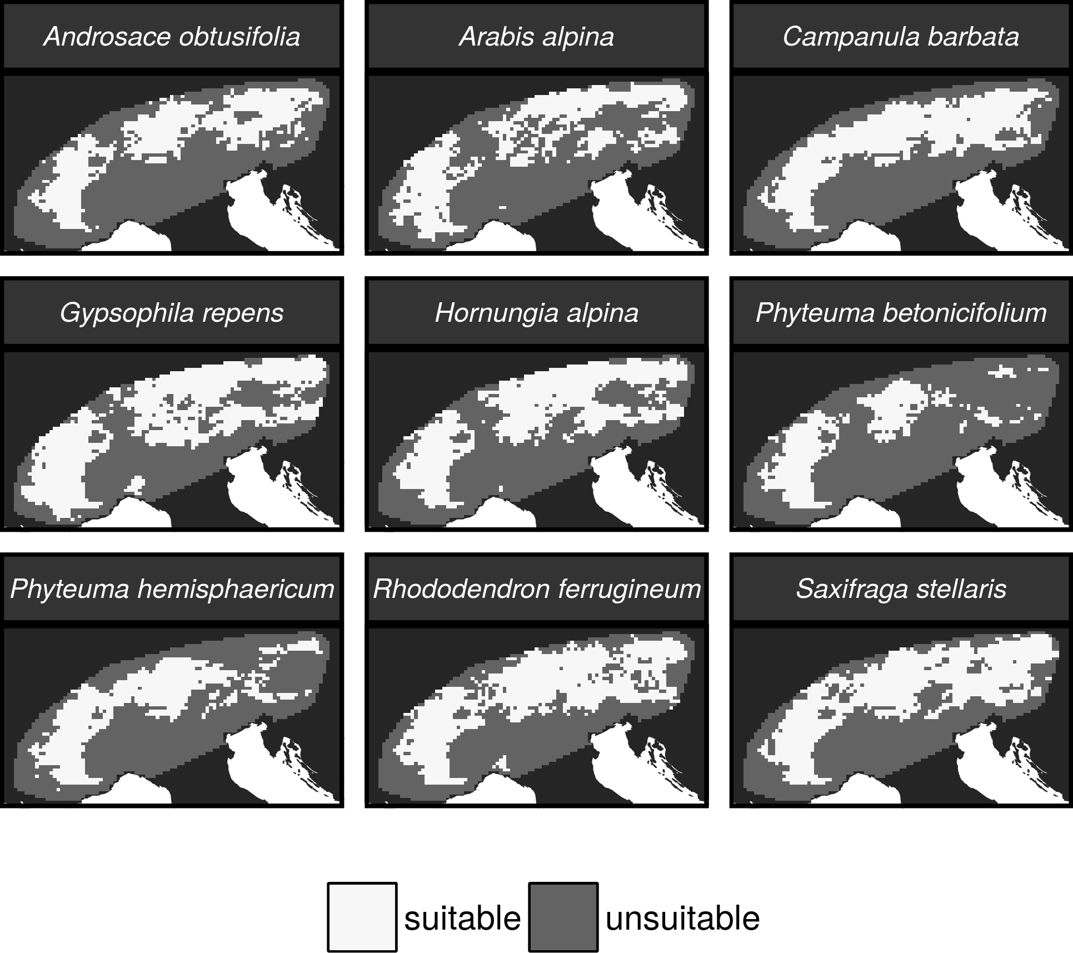
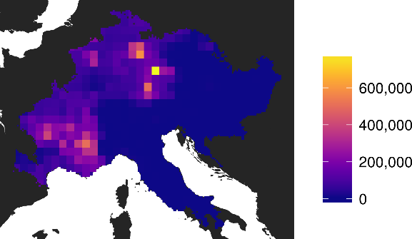
Environmental data
Suitable habitat
Occurrence records
from online database
Suitable
Unsuitable

Slide 37
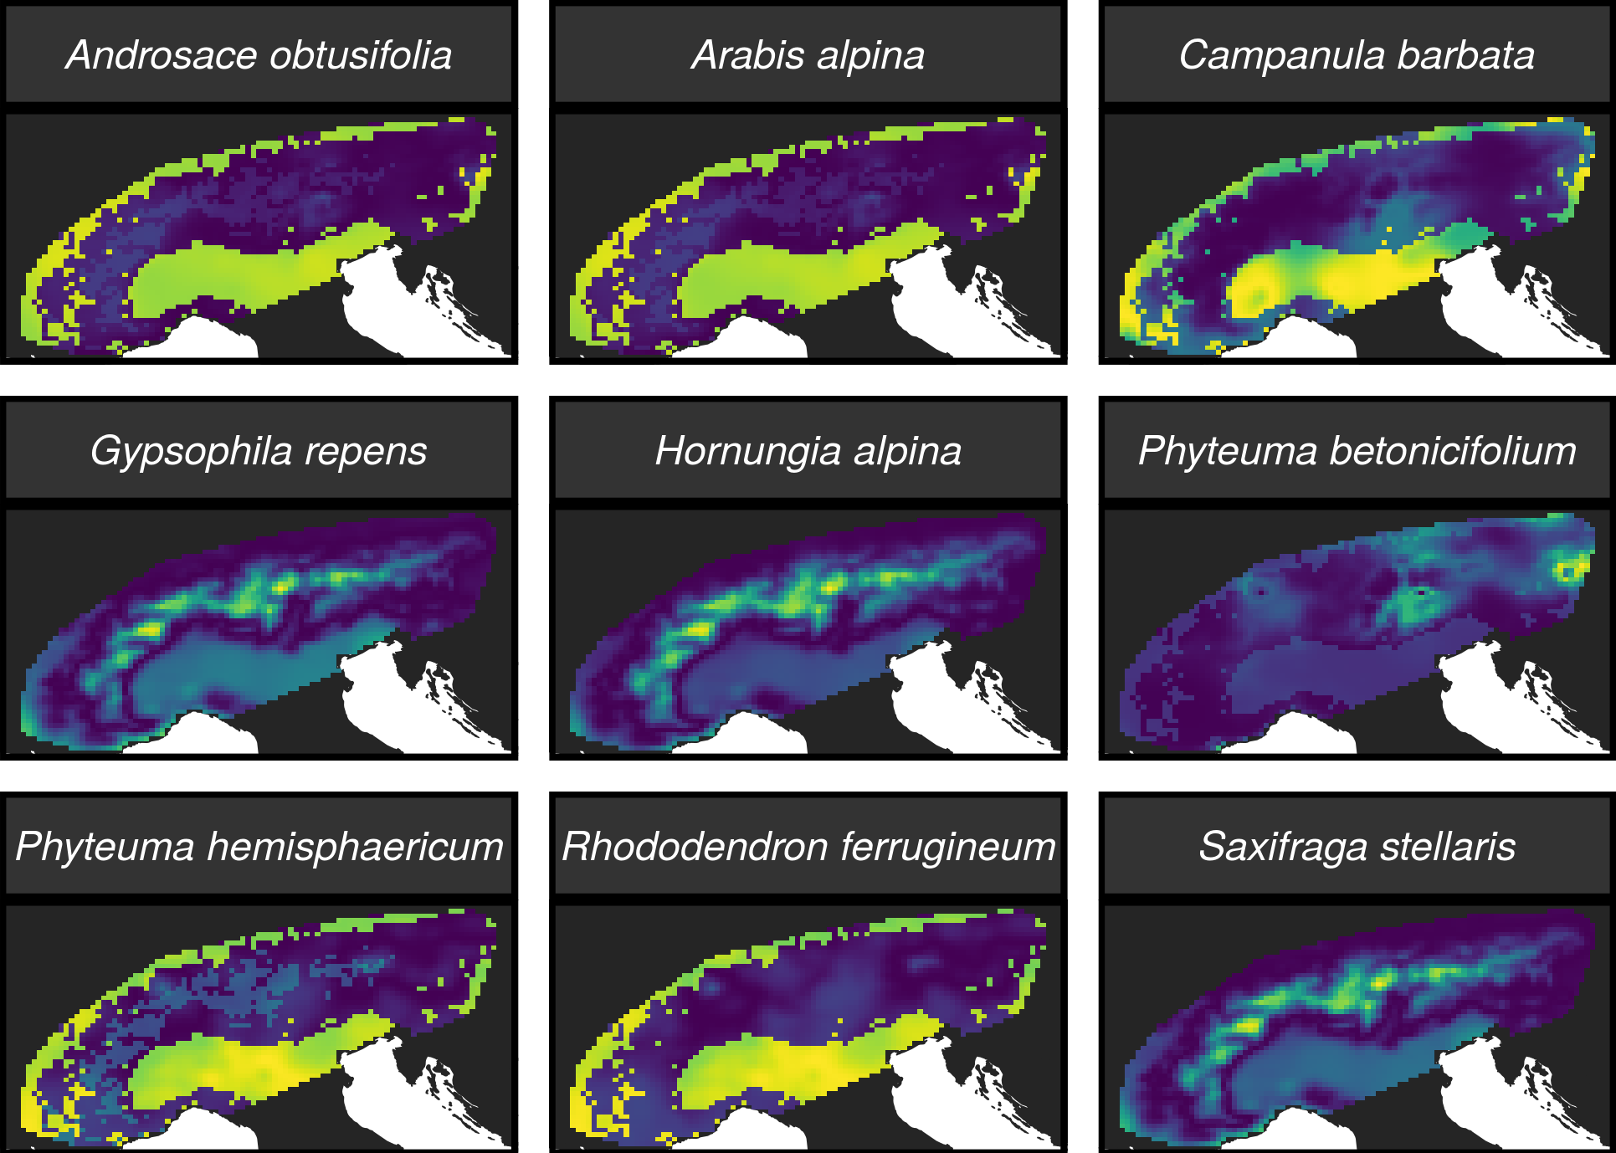
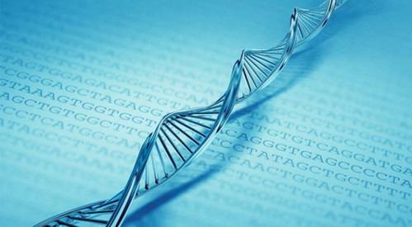
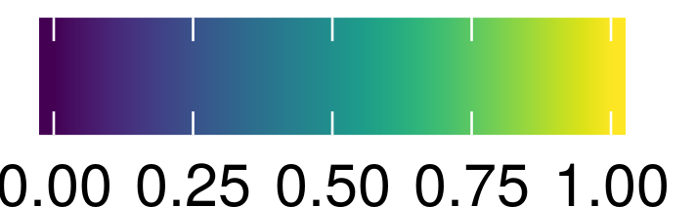
Environmental data
Resistance to gene flow maps
Genetic data

Slide 38
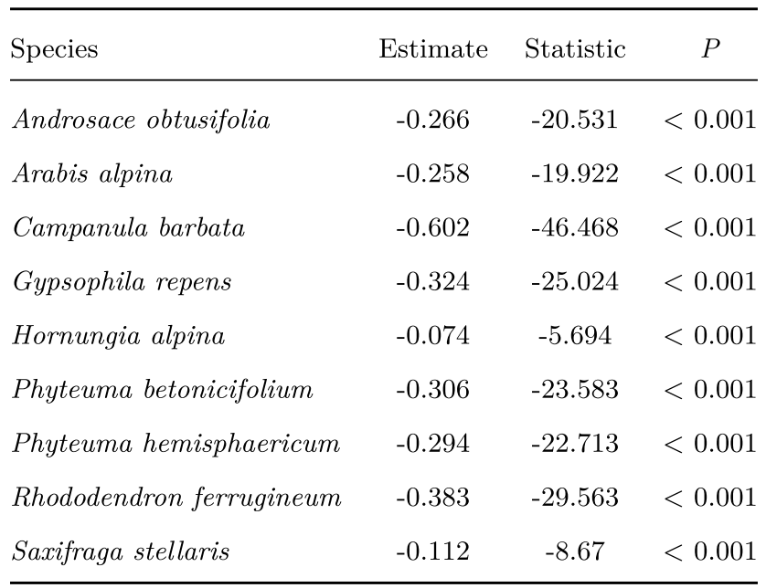

Does habitat suitability correlate with resistance to gene flow?

Slide 39
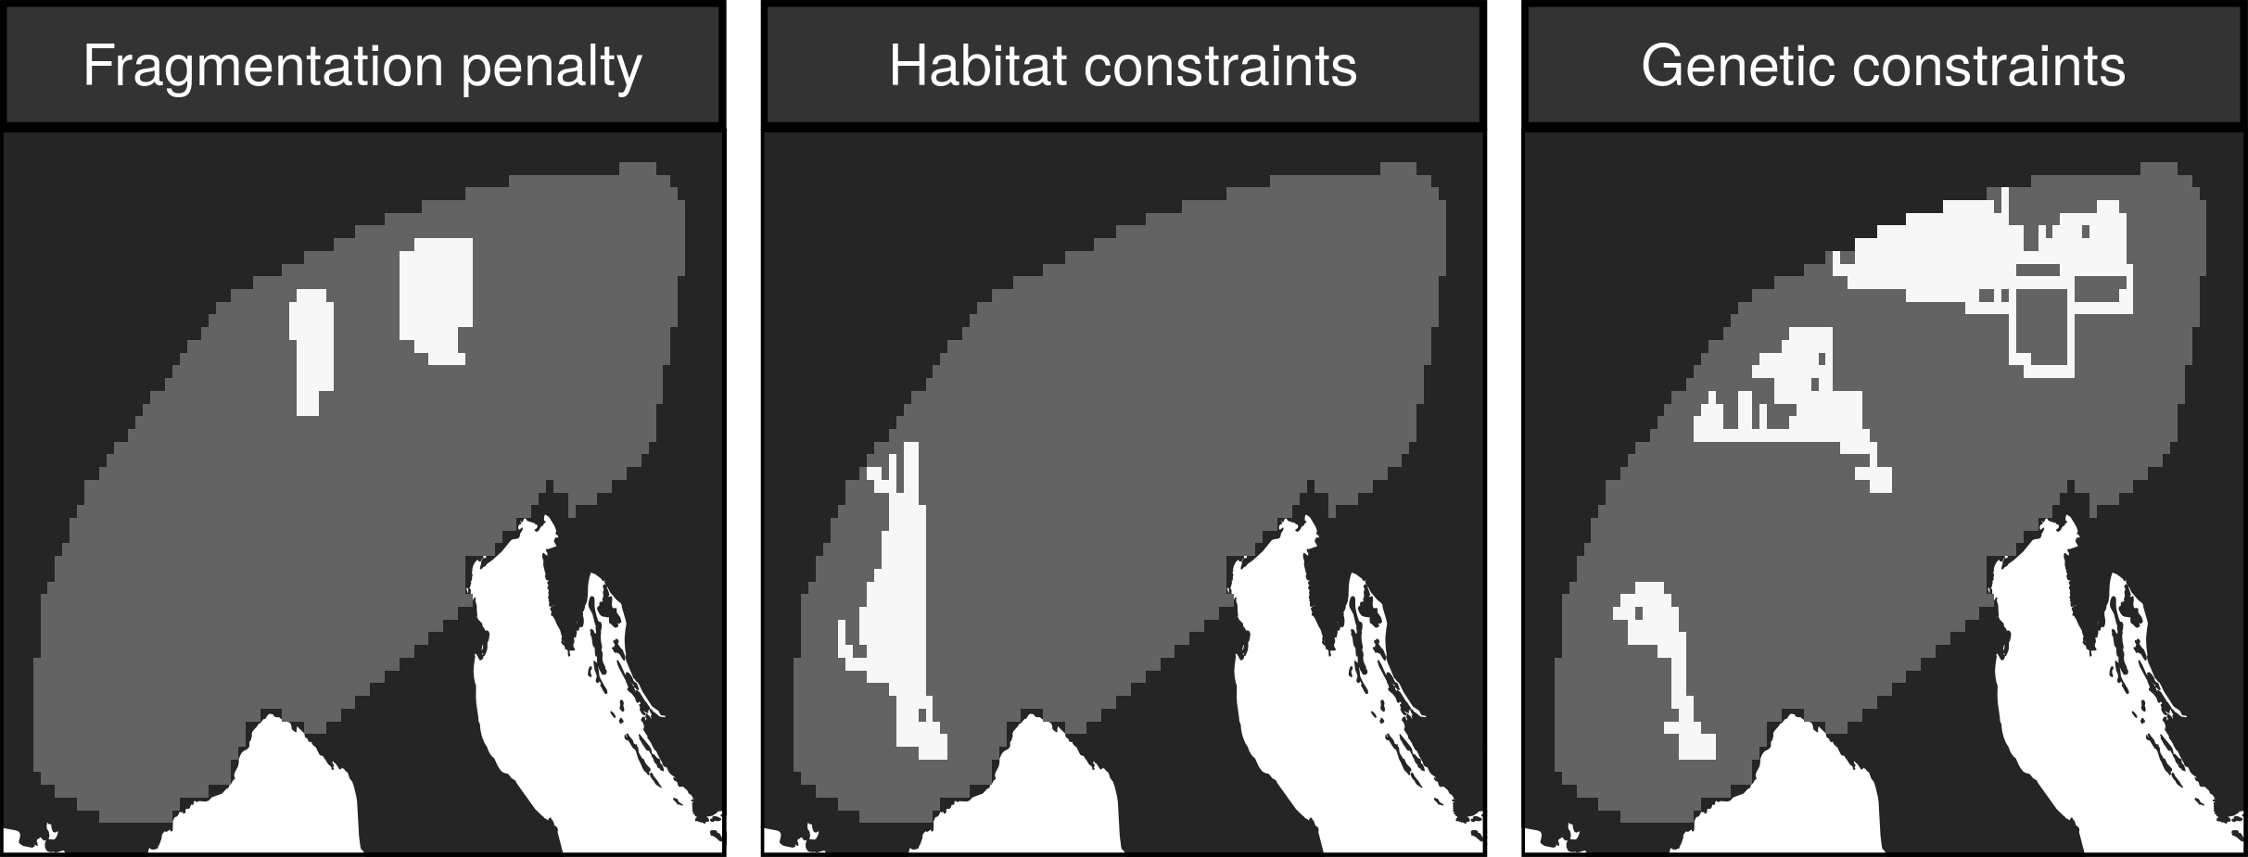
Do we need genetic data to maintain gene flow?

Slide 40
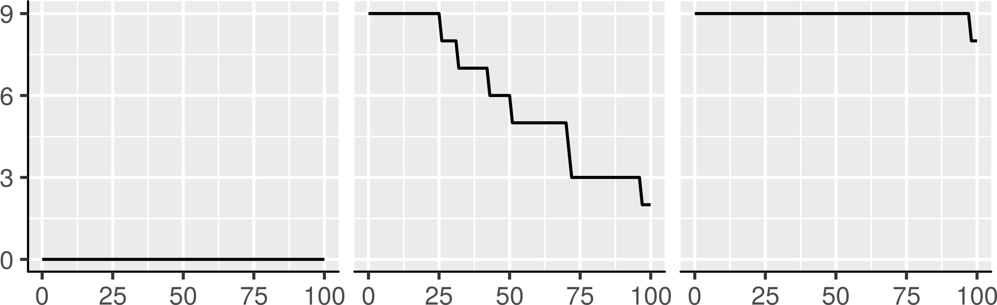
Do we need genetic data to maintain gene flow?
Percent of species with
gene flow maintained
Strength of gene flow required in prioritization
(percentile threshold)

Slide 41
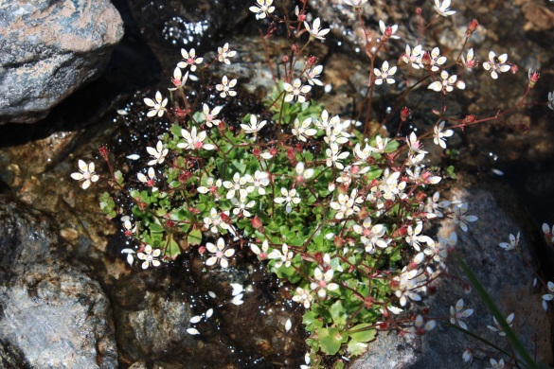
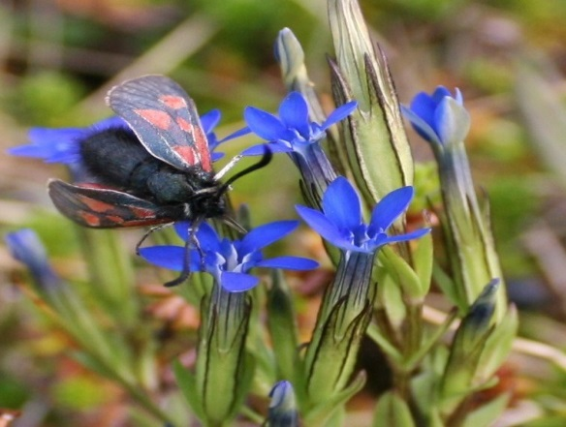
Prioritizations need gene flow data
Genetic data was needed to make prioritizations that could maintain strong levels of gene flow
Potentially complicated by dispersal mechanisms
We can incorporate species-specific connectivity into prioritizations

Slide 42
How well are existing protected areas covering species’ realized niches?
In prep.

Slide 43
Evolutionary processes
Species range
Population

Slide 44
Species data
9,670 bird, 5,070 mammal, 5,197 amphibian species
5 × 5 km maps delineating suitable habitat
Split each species’ distribution into 10 “environmental” partitions
Habitat targets set following standard approaches

Slide 45
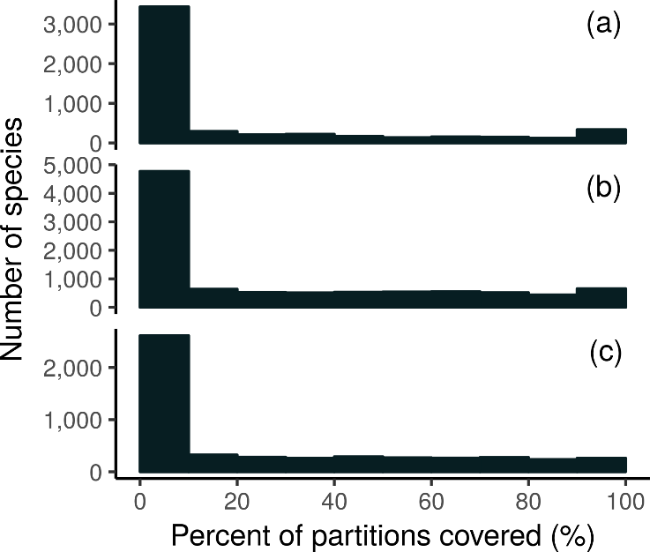
How good is the existing protected system?
Amphibians
18,688 (94%) species are not adequately represented in reserves
8,921 (45%) species do not have a single partition adequately represented
Of these 8,921 species, 2,266 species are globally imperilled
Birds
Mammals

Slide 46
Giant Panda
Local adaptations
in immune system

Slide 47
Italian Agile Frog

Slide 48
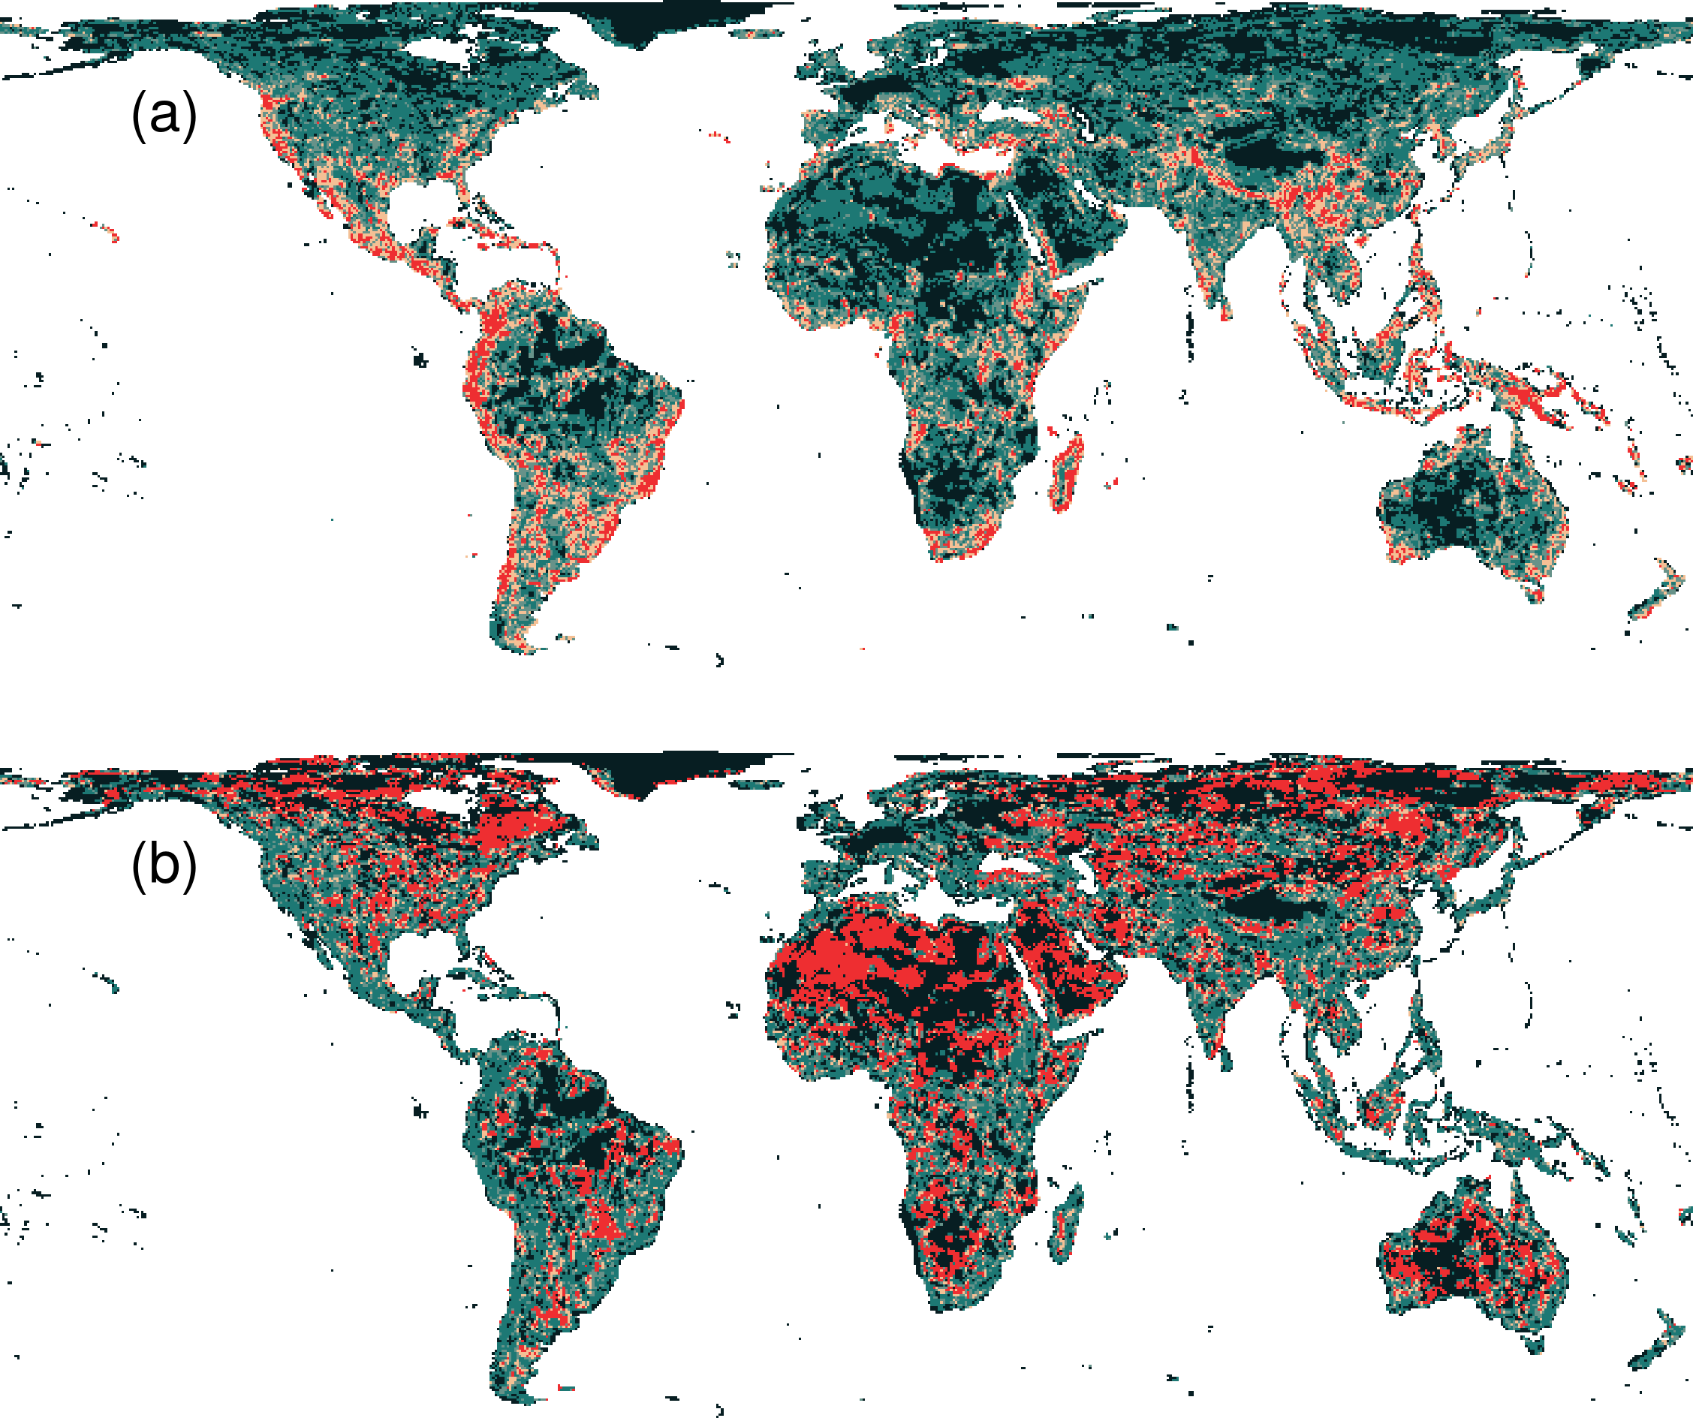
Prioritization for realized niches
35.9 % of the Earth’s land needed to complement existing protected areas
Biodiversity hotspots are critically important
Conservation efforts needed across the planet

Slide 49
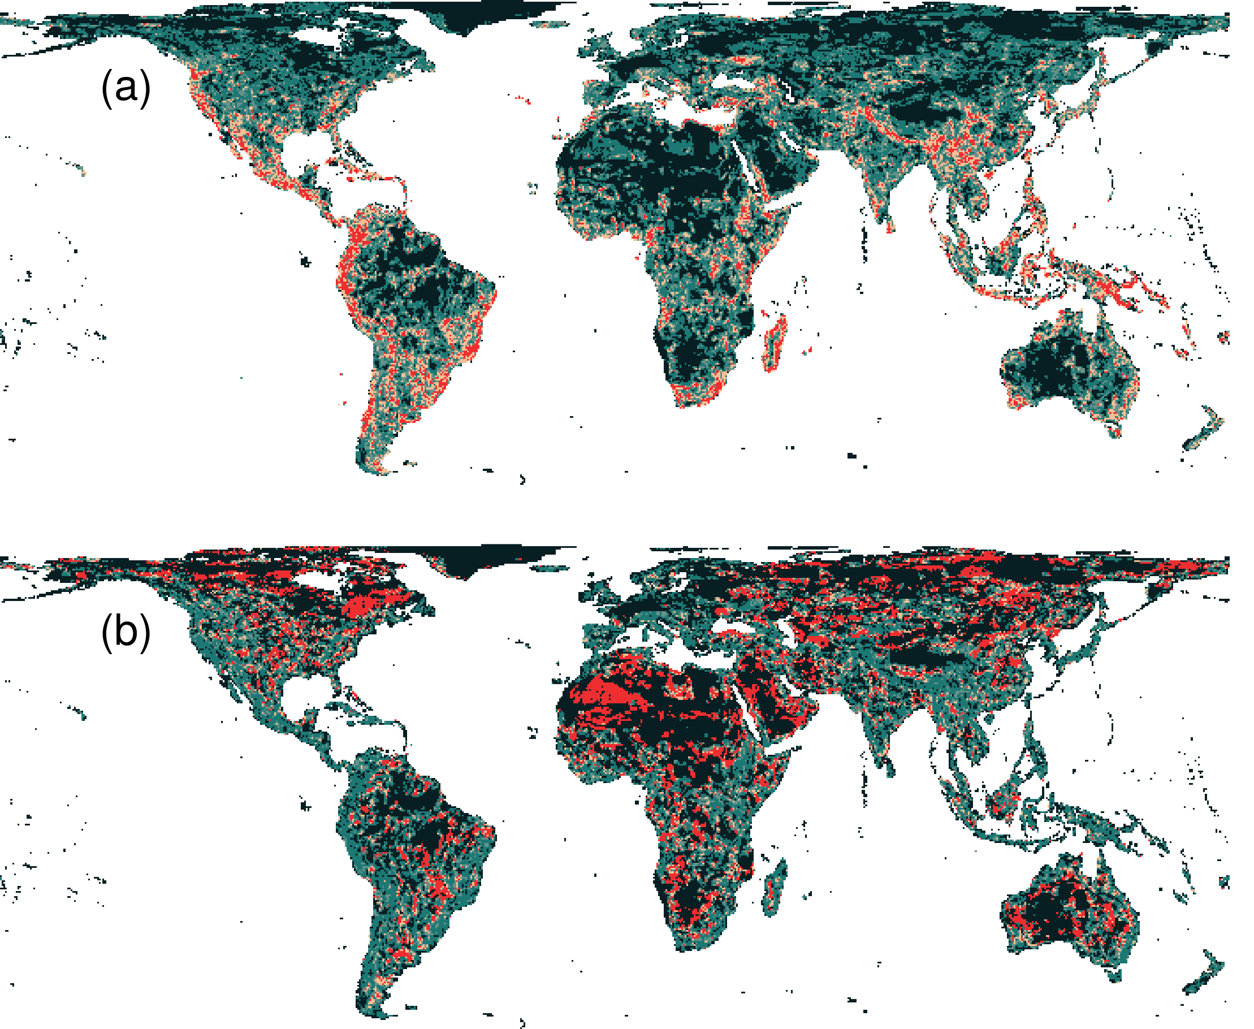
What if we ignore species niches?
Only 3.7% less of the Earth’s land than prioritization which considers niches
Fails to adequately represent 7,989 (40%) species

Slide 50
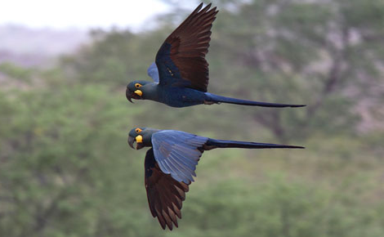
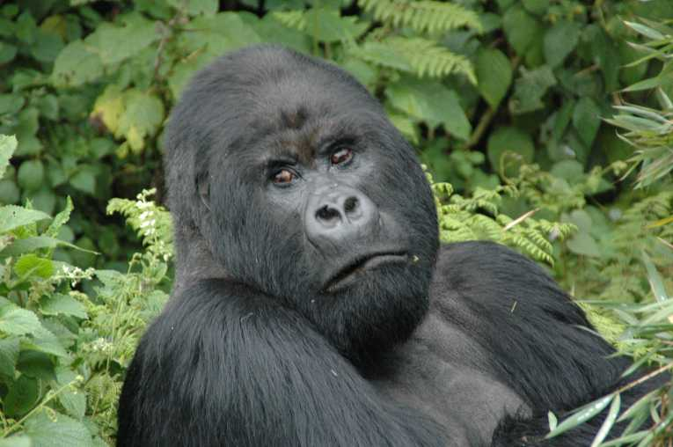
Global conservation of realized niches
Current protected area system is insufficient
More protected areas are needed to fill the gaps
Future conservation efforts need to explicitly account for environmental variation

Slide 51

Try it out yourself?
raptr R package
Target intra-specific variation in prioritizations
prioritizr R package
General-purpose prioritizations
wdpar R package
Download and clean protected area data
Available on CRAN!

Slide 52
Take home messages
If you really want it: you need to plan for it
Surrogates may work for some applications of genetic data – no guarantees!

Slide 53



jeffrey.hanson@uqconnect.edu.au
github.com/jeffreyhanson
jeffrey-hanson.com

